Slide 1
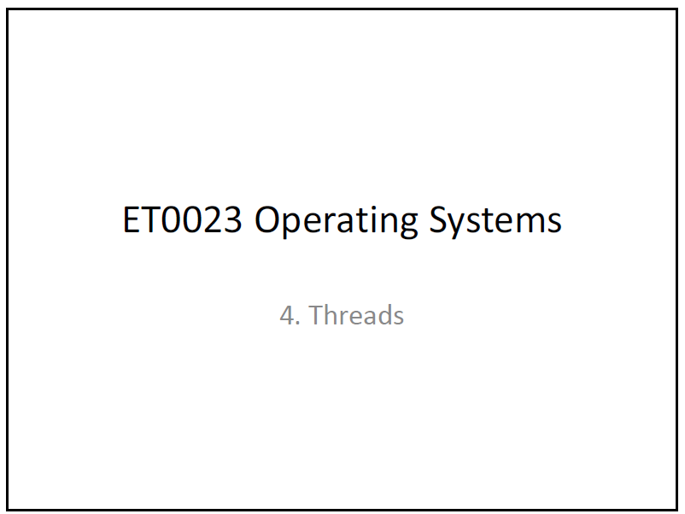

Slide 2
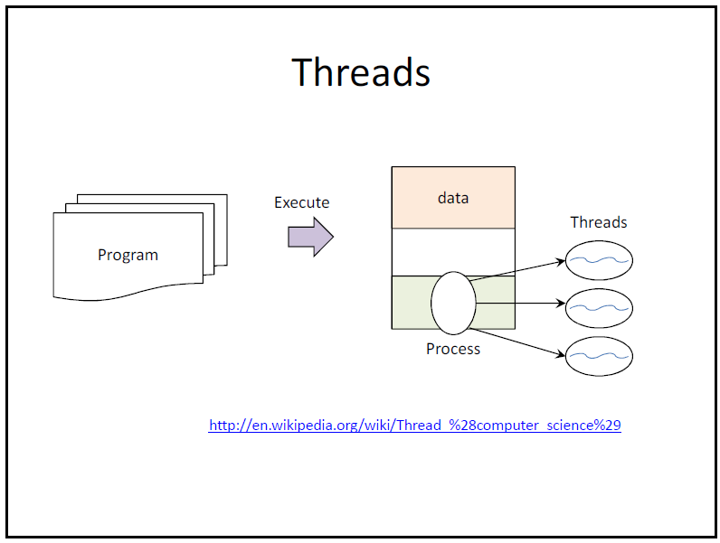

Slide 3
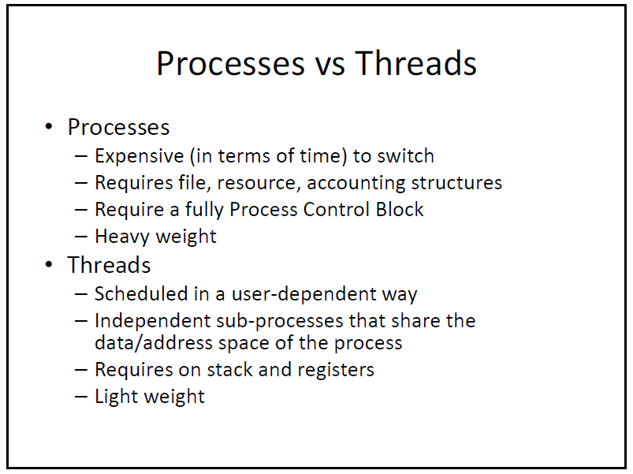

Slide 4
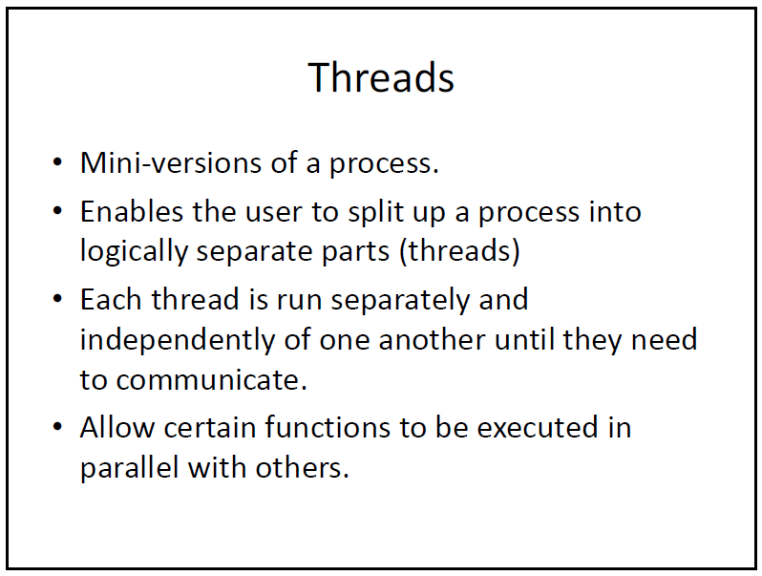

Slide 5
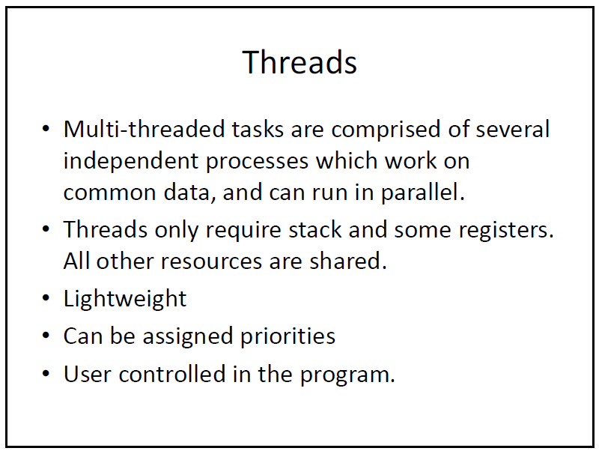

Slide 6
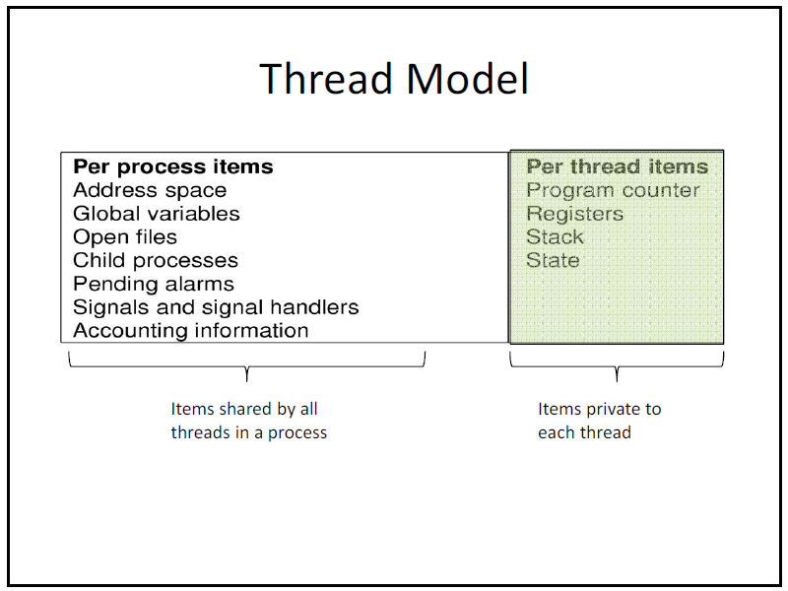

Slide 7
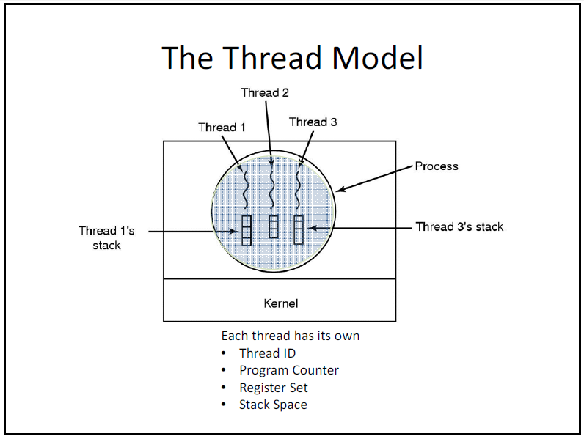

Slide 8
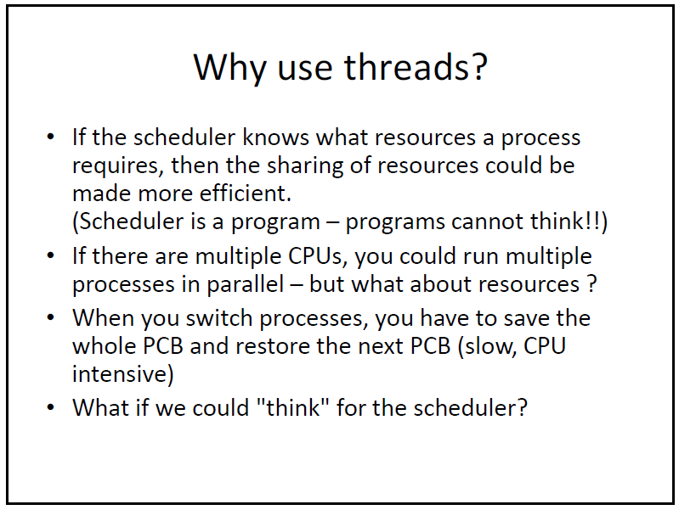

Slide 9
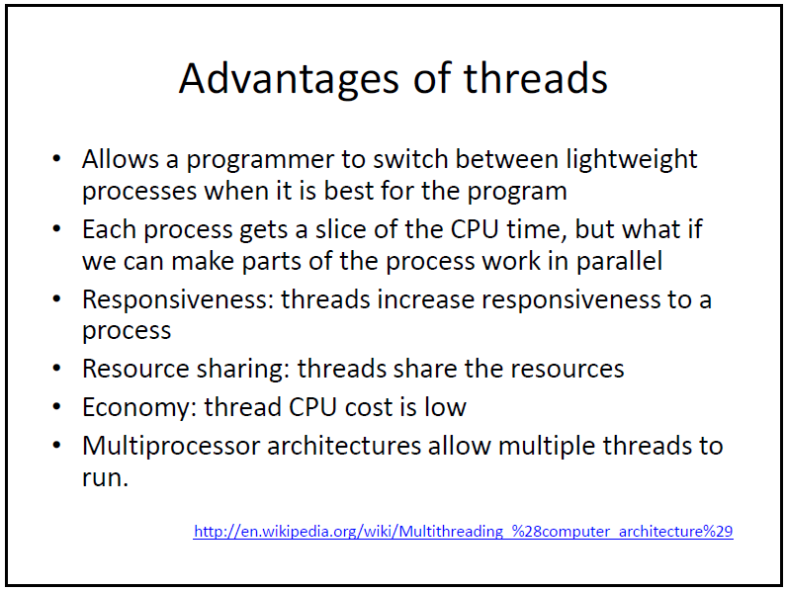

Slide 10
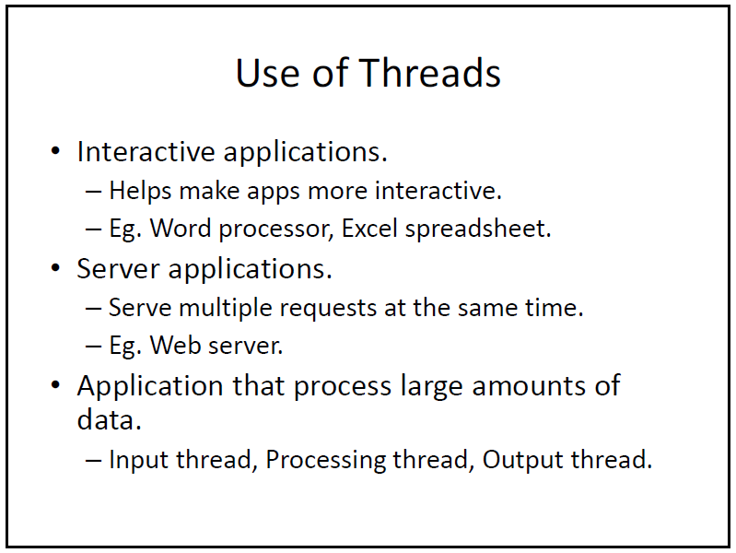

Slide 11
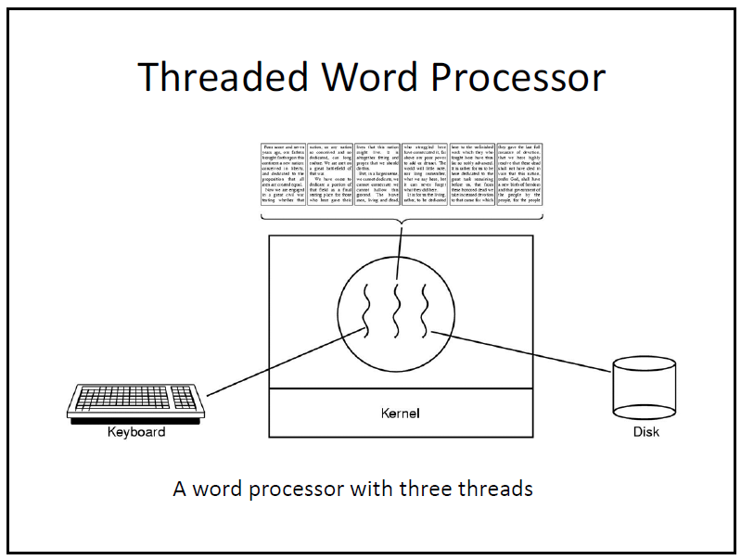

Slide 12
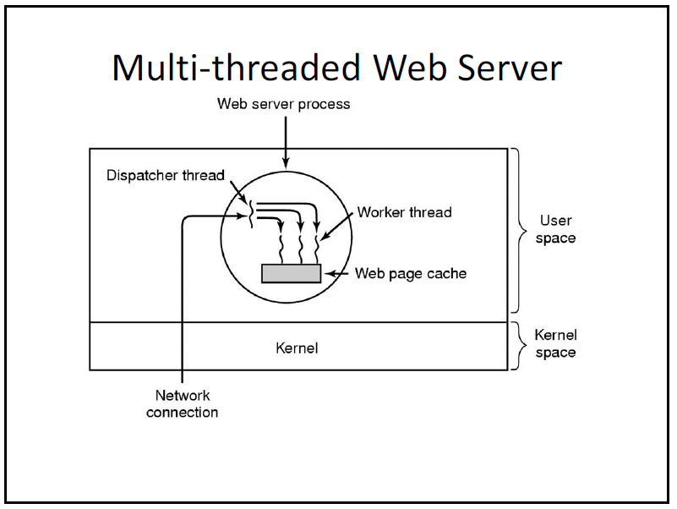

Slide 13
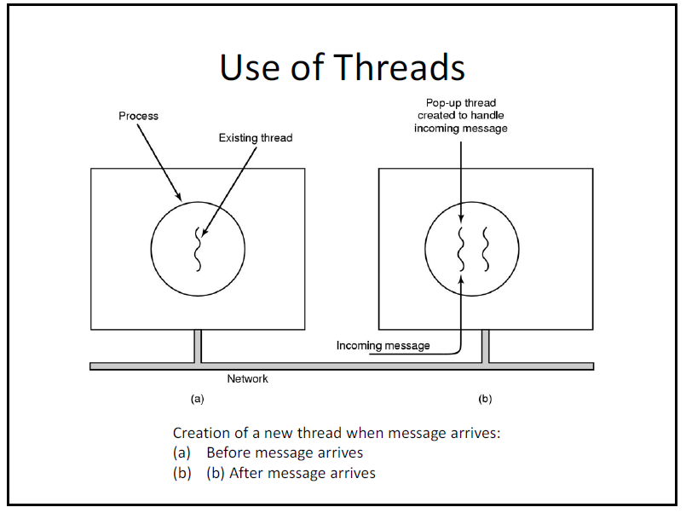

Slide 14
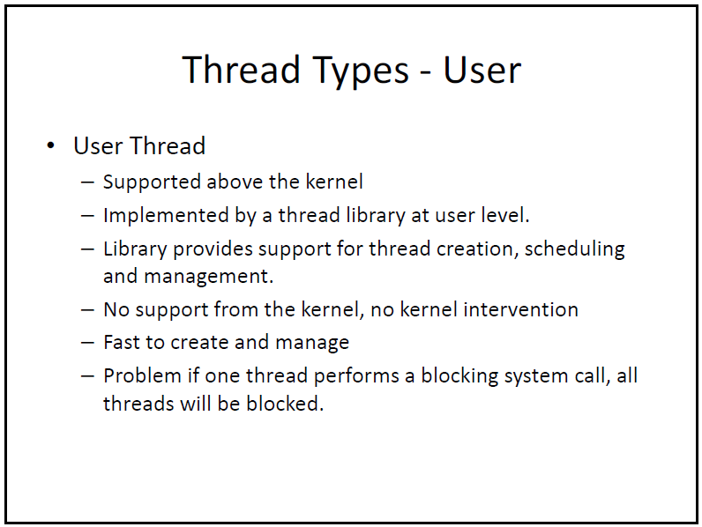

Slide 15
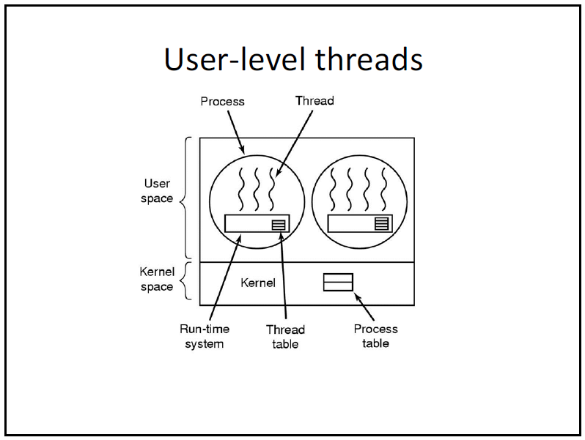

Slide 16
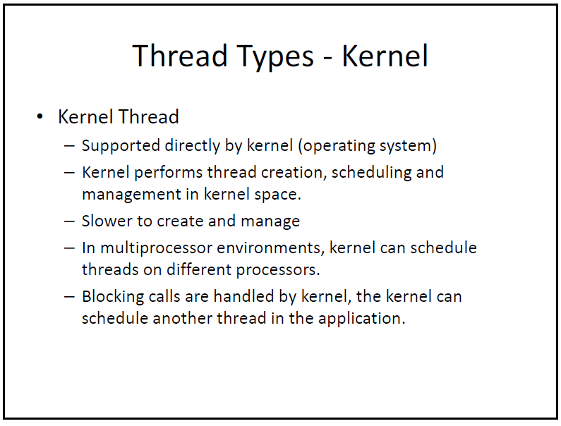

Slide 17
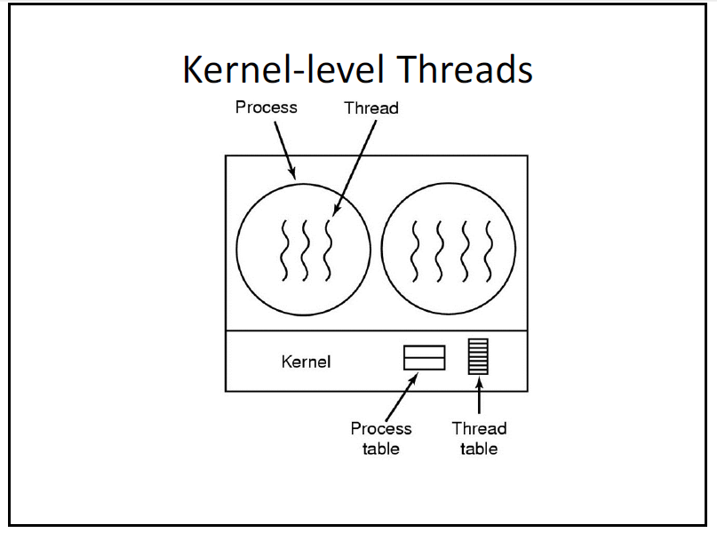

Slide 18
Multi-Threading
 | Time slice 1 | Time slice 2 | Time slice 3 | Time slice 4 | Time slice 5 | Time slice 6 | Time slice 7
Thread 1 | Running | Idle | Idle | Idle | Idle | Running | Idle
Thread 2 | Idle | Running | Idle | Running | Idle | Idle | Idle
Thread 3 | Idle | Idle | Running | Idle | Running | Idle | Running
Intel Multicore Hyperthreading - YouTube

Slide 19
